Slide 1
Musical Cubes
“The Three Sided Die”
Eli Doggart, Owen Krause, Matthew Sweeney

Slide 2

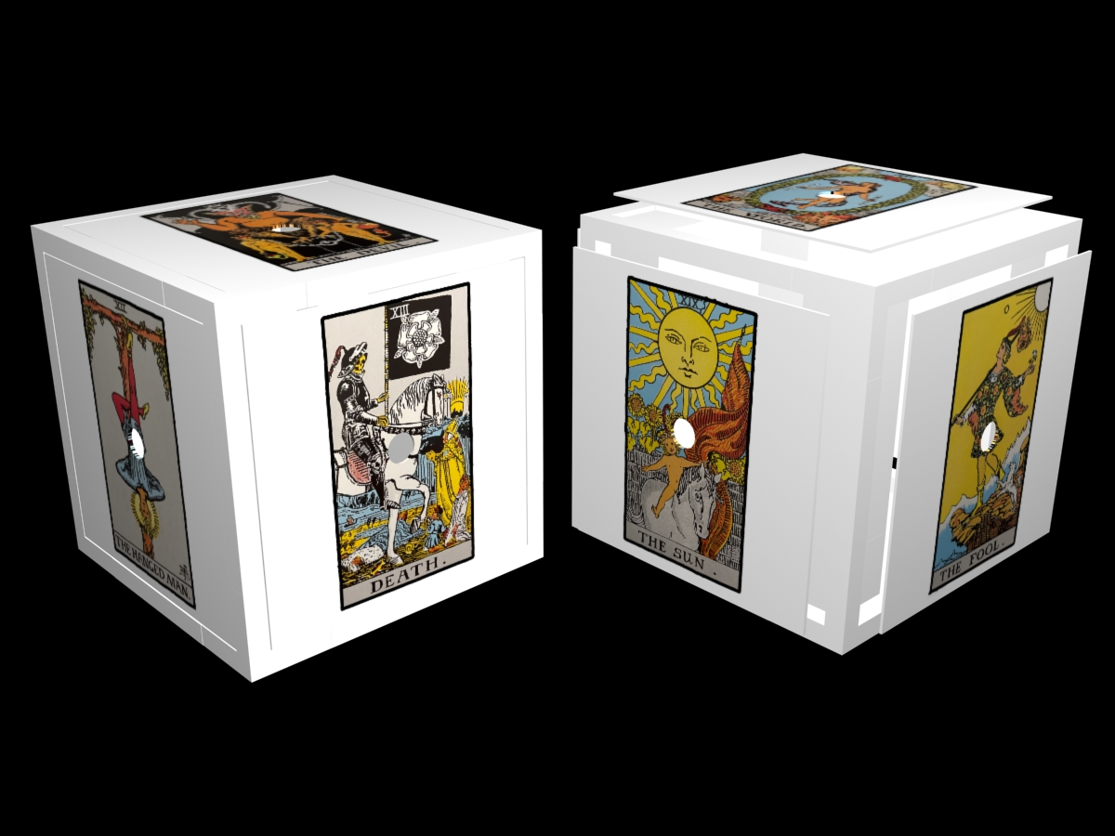
Goal
Design and fabricate a cube that connects to a computer and based on the side it lands on when rolled commands a musical result.

Slide 3
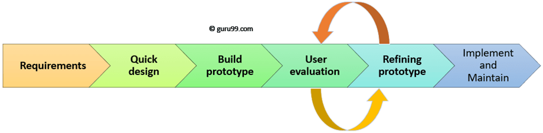
Term Plan
Develop and understanding of requirements
Select components and design cube around them
Fabricate cube
Evaluate cube
Prototype design
In programming phase

Slide 4
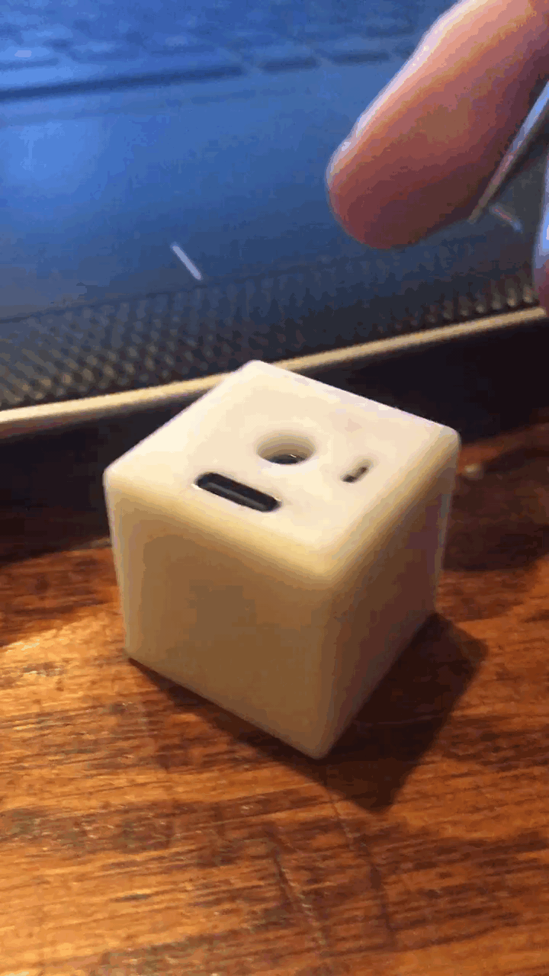
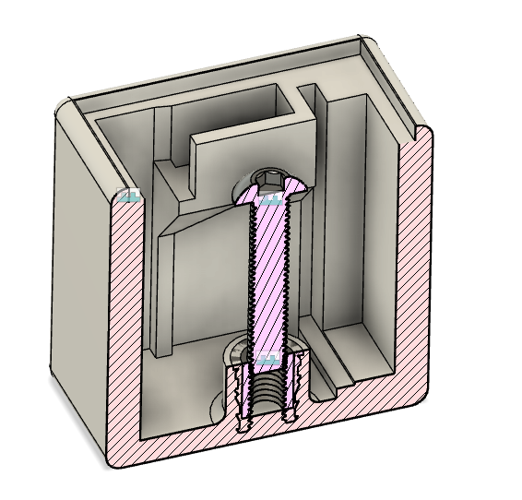
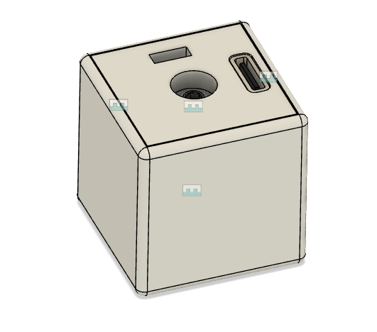
Accomplishments
Received parts
Added an on off switch to design
Soldered and constructed cube
Did some preliminary testing and programming testing the capabilities

Slide 5
Challenges
Soldering in tight spaces
Reformatting the microcontroller (oops)
Transmitting data over bluetooth from the cube

